Slide 1

Food Recipe Suggestion
from Detected Ingredients
EasyChef
Presented by Group 4:
Chotiros Srisiam #101411914
Pat Boonprasertsri #101410612
Pek Chansatit #101439953

Slide 2
Problem
Statement
"Many customers struggle with meal planning while shopping, leading to frustration and inefficiency. The client seeks to address this challenge by offering a solution that simplifies meal planning and enhances the overall shopping experience."

Slide 3



Why this problem matters..
Efficient meal planning enhances enjoyment of the shopping experience.
Streamlined processes increase customer satisfaction, and loyalty.
Improved enjoyment leads to repeat business and positive word-of-mouth.

Slide 4
Project
Background
Client Objectives:
Enhance the mobile app to make shopping more enjoyable by suggesting recipes based on ingredients in-store.
Importance of Technology:
In today's digital age, leveraging technology is crucial for businesses to stay competitive. By integrating advanced technology like image recognition and recipe suggestion features, the client aims to enhance customer engagement and loyalty.

Slide 5
1
Custom Development
2
Integration of Pre-built Solution
3
Collaborative Development
Option Presentation
& Evaluation

Slide 6
Preferred Option
Integration of Pre-built Solution
Alignment with Evaluation Criteria:
Meeting Business Requirements:
Rapid Development
Cost-Effectiveness
Risk Mitigation
Enhancing Customer Experience
Driving In-Store Purchases
Increase Customer Engagement

Slide 7
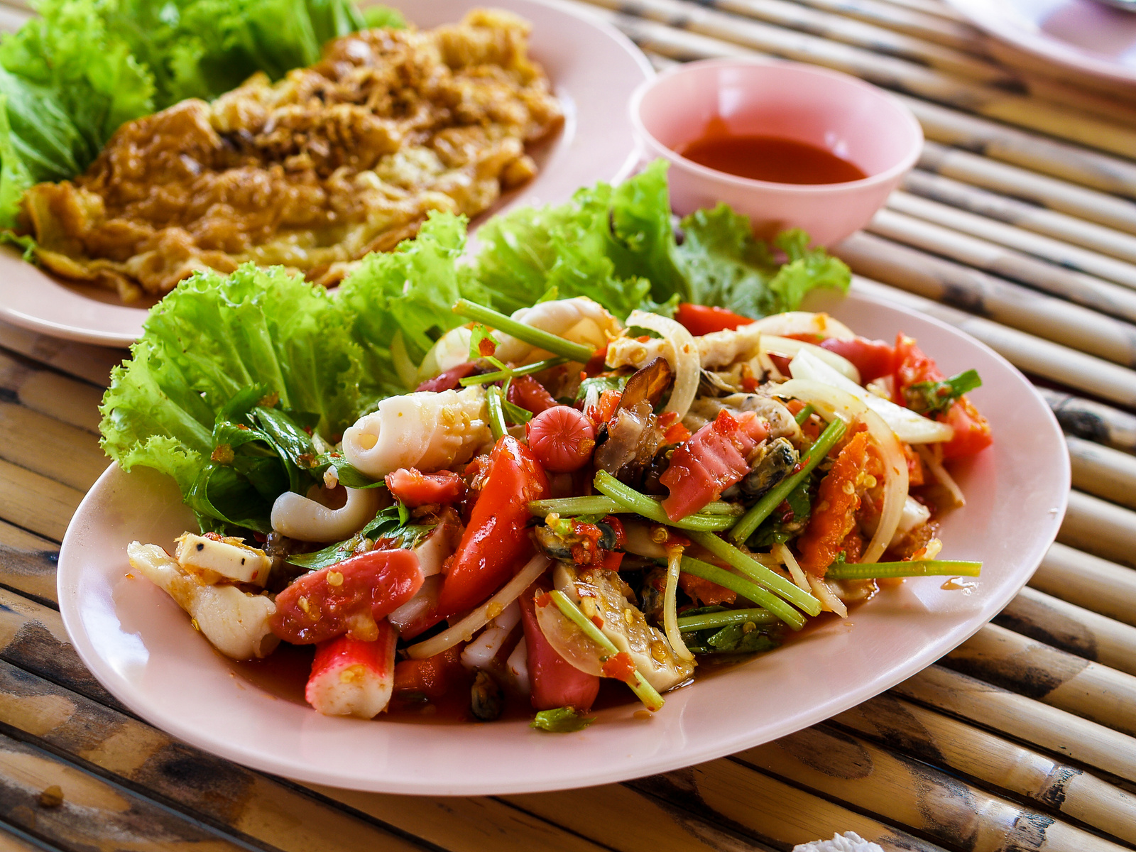

Integration of
EasyChef
Solution
for grocery retailer
Let’s enjoy grocery shopping!

Slide 8
Project
Definition
Objectives:
Improve Customer Experience
Increase User Engagement
Drive In-Store Purchases
Scope:
Business Requirements:
Enhance client’s app with a feature enabling personalized recipe suggestions based on in-store ingredients.
Ingredient Recognition
Recipe Recommendation Engine
User Interaction
Integration with Existing Systems

Slide 9
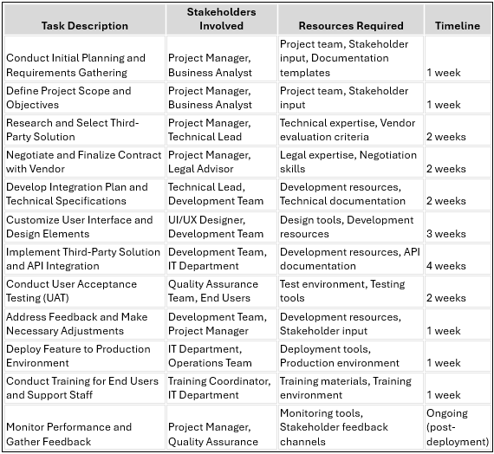
Project
Implementation
Plan

Slide 10
Financial Analysis
Cost
Benefit
Total cost: $60,000
Total Benefit: $150,000
Net benefits: $90,000
Break
Even
6,000 customers
*Assuming an average sale price of $20 per customer and variable costs of $10 per customer
Annual Revenue Projection: $100,000
Annual Cost Savings: $20,000
Total Annual Benefit: $120,000
Projected Annual Net Benefit: $110,000
ROI
150%
Forecast

Slide 11
Resource Required
Intellectual Resources:
Human Resources:
Financial Resources:
EasyCook Solution
Access to documentation
Project Team:
Project Manager
Business Analyst
Technical Lead
Development Team
Stakeholders:
Representatives from the client’s management
IT department
Marketing department
Operations team
Licensing or subscription fees for the pre-built solution.
Development and integration costs.
Ongoing maintenance and support fees.
Contingency funds for unforeseen expenses or project scope changes.

Slide 12
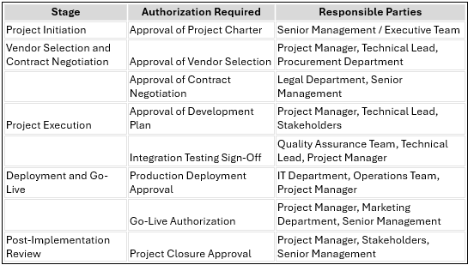
Authorizations

Slide 13


Literature Review
yummly
foodcombo
EasyChef
Recipe Suggestion
Save Recipe
Select Ingredients
Ingredient image detection
Mobile App Integration

Slide 14
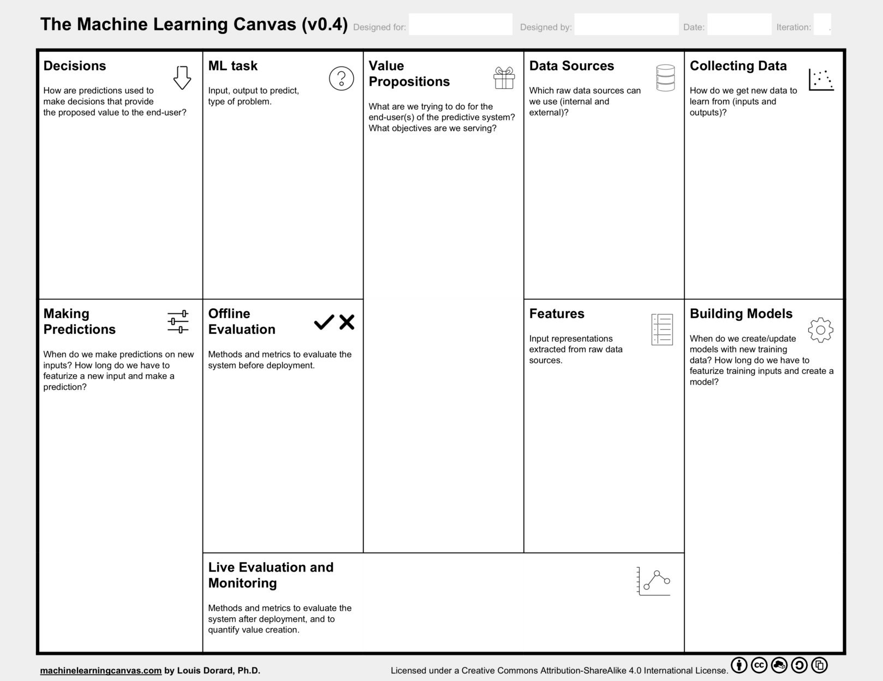
Predictions (recommended recipes) are based on the combined set of ingredients from multiple input images.
Users can decide whether to view the full recipe details, save the recipe, or dismiss the suggestion and try another.
Input: Images of ingredients.
Output to predict: Recommended food recipes.
Type of problem: Image classification (ingredient recognition) and recommendation system.
Provide personalized recipe suggestions based on a combination of available ingredients from multiple input images.
Enhance user convenience by allowing flexible input methods for ingredient selection.
Save time and effort in meal planning and recipe discovery.
Inspire creativity in cooking by suggesting new recipes based on familiar ingredients.
Internal: User-uploaded ingredient images
External: Public recipe databases, food image datasets (e.g., Food-101, Recipe1M+).
Inputs: Users can input or select multiple ingredient images based on their availability through the app's image upload or selection feature.
Outputs: Collect recipe data from external sources or allow users to submit recipes along with images.
For ingredient images: Extract features using convolutional neural networks (CNNs).
For recipe data: Utilize text processing techniques to extract relevant features such as ingredients, cooking instructions, and user ratings.
Predictions are made in real-time as users input or select ingredient images.
Featurization and prediction occur within seconds to provide a seamless user experience, with additional processing time required for aggregating features from multiple images.
Methods: Cross-validation, holdout validation, and evaluation on a separate validation dataset.
Metrics: Accuracy, precision, recall, F1 score for ingredient recognition; user satisfaction surveys for recipe recommendations.
Models are updated periodically based on the availability of new data and improvements in algorithmic techniques.
Featurization and model training duration depend on the complexity of the dataset and computational resources available. Typically, featurization can take hours to days, and model training can take several hours to weeks.
Method: Monitor user interactions with the app, including recipe views, saves, and feedback.
Metrics: User engagement metrics (e.g., number of active users, session duration), retention rate, user satisfaction ratings, and feedback.
Methodology
Notes:
For multiple ingredient images: Aggregate features from each image to represent the combined set of ingredients.

Slide 15
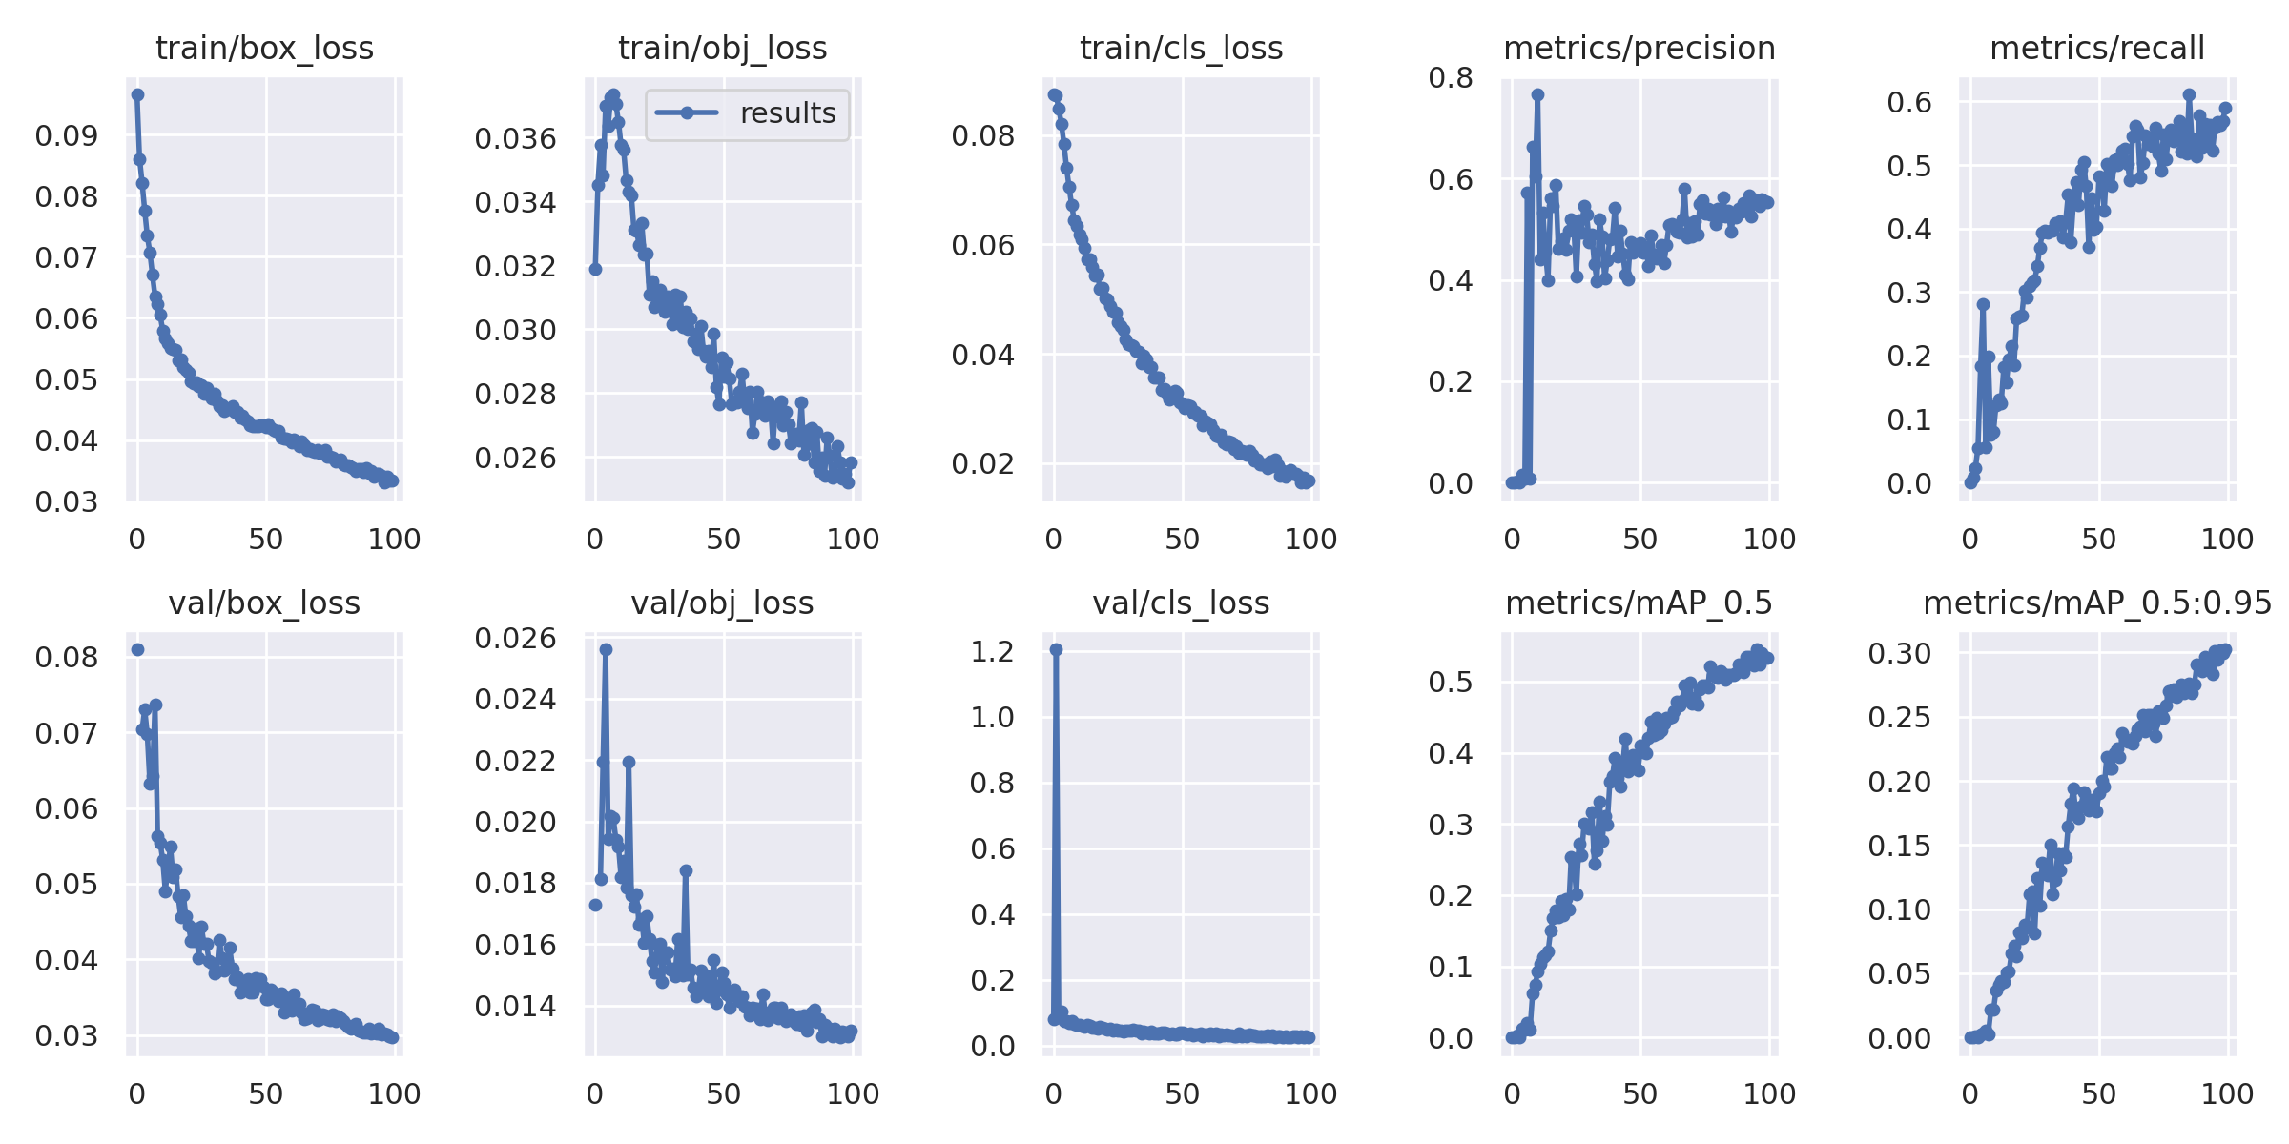
Model Benchmarking
YoloV5

Slide 16
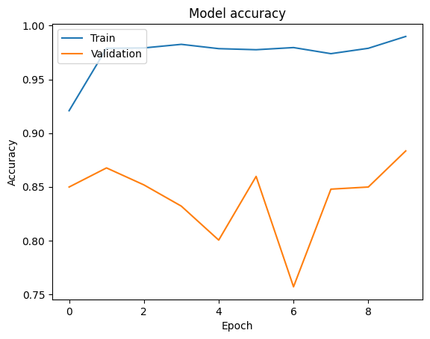
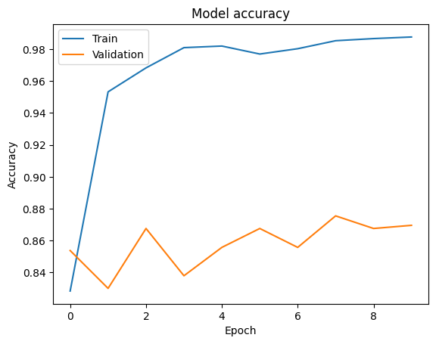
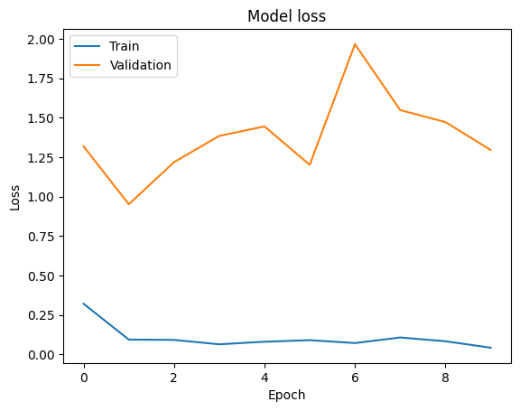
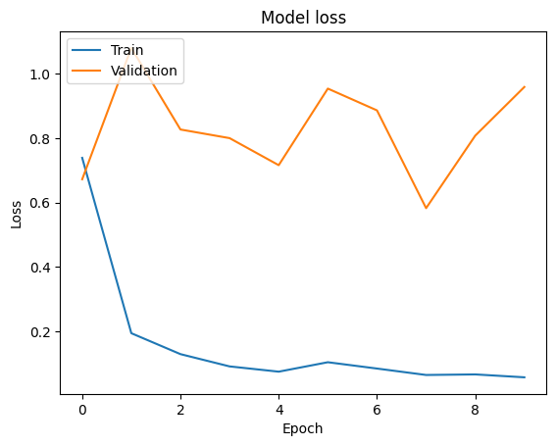
Model Benchmarking
MobilenetV2
Resnet50

Slide 17
Model Benchmarking
YoloV5
MobileNetV2
Resnet50
Accuracy
0.539
0.990
0.988
Loss
0.017
0.043
0.057
Recall
0.564
0.246
0.601
Precision
0.557
0.350
0.627

Slide 18
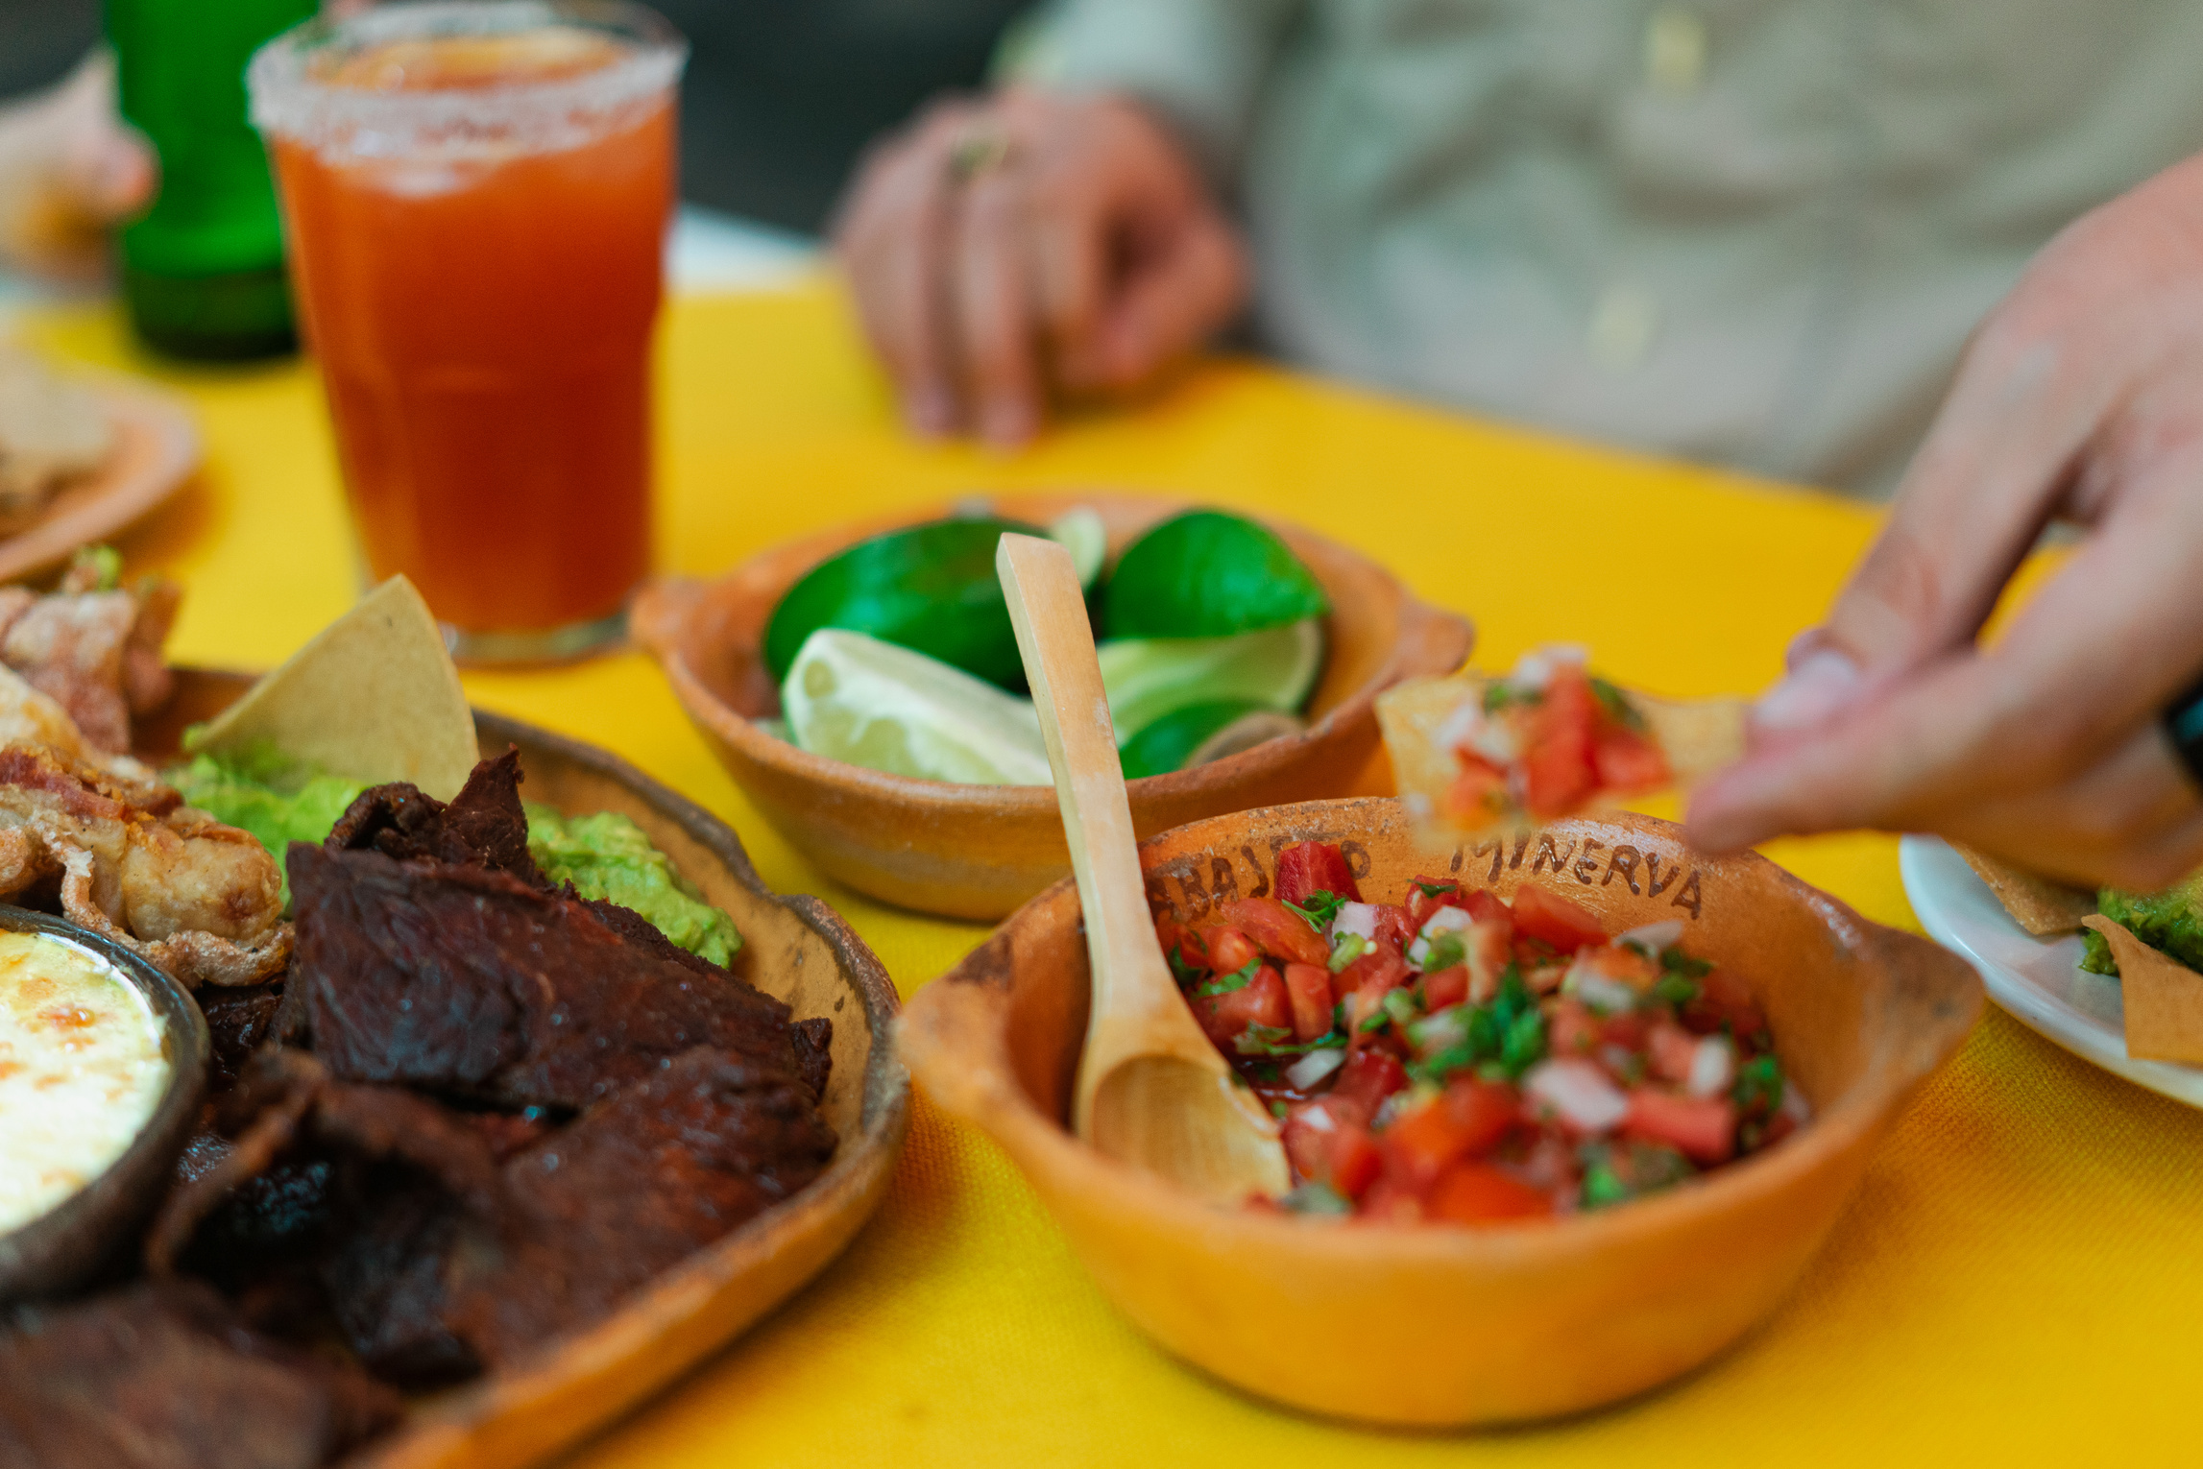

Model Deployment
Transition from Notebook to Production:
Converting Jupyter notebook code to standalone scripts
Script to Web Service:
Using Flask for website framework and FastAPI for API endpoints detection
Containerization with Docker:
Benefits of containerization for reproducibility and scalability
Cloud Hosting:
Deployment options on cloud platforms using DigitalOcean
Consideration for Web Application Deployment:
Brief mention of potential web application deployment strategies
Notes:
Training Detection Model in Jupyter Notebook:
Train the ingredient detection model using a suitable machine learning or deep learning framework in a Jupyter Notebook environment.
Fine-tune the model using a labeled dataset of ingredient images to improve accuracy and performance.
Convert Notebook into Python File:
Convert the trained model code from the Jupyter Notebook into a standalone Python script for easier integration and deployment.
Build API for Ingredient Detection and Recipe Finding:
Develop an API using a web framework like Flask or FastAPI to expose endpoints for ingredient detection and recipe finding.
Integrate the trained detection model into the API to process image uploads and return detected ingredients.
Implement functionality to find recipes based on the detected ingredients using an external recipe database or API.
Build Web Application:
Develop a web application using HTML, CSS, and JavaScript to provide a user interface for uploading images and viewing results.
Design the application layout, including sections for image upload, model selection, and result display.
Implement client-side interactions using JavaScript to enhance user experience and responsiveness.
Dockerize the Application:
Containerize the web application and API using Docker to create a portable and isolated environment for deployment.
Write a Dockerfile to specify the application dependencies, environment configuration, and runtime settings.
Build a Docker image containing the application and its dependencies using the Docker CLI or Docker Compose.
Deploy Web Application to Cloud Server:
Choose a cloud service provider like AWS, Google Cloud Platform, or Microsoft Azure for deploying the application.
Create a virtual machine or container instance on the cloud server to host the Dockerized web application.
Deploy the Docker image to the cloud server using container orchestration tools like Kubernetes or Docker Swarm.
Configure network settings, security groups, and domain mapping to make the web application accessible over the internet.
Monitor the deployed application for performance, availability, and security using cloud monitoring tools and logging services.

Slide 19
1
Dataset label (Recipe format, limited labeled data)
2
Image format (From Mobile Phone)
3
Limit resource (e.g., CPU, GPU, memory, and disk space)
Challenges &
Issues Encountered
Notes:
Training Dataset:
Difficulty in finding a comprehensive and diverse training dataset for ingredient detection models.
Limited availability of labeled data for training deep learning models.
Image Format:
Handling various image formats like PNG, JPEG, HEIC, and HEIF poses challenges in preprocessing and compatibility.
Cloud Server Limitations:
Constraints on server resources such as CPU, memory, and disk space can limit the scalability and performance of the application.
Challenges in managing server load during peak usage times, leading to potential downtime or slow response times.
Model Selection:
Selecting the most suitable model for ingredient detection can be challenging due to differences in accuracy, speed, and resource requirements.
Evaluating and comparing multiple models to determine the best fit for the application.
Recipe Data Format:
Inconsistencies and variations in the format of recipe data, such as mixed instructions and ingredients separated by commas, require robust parsing and processing algorithms.
Model Deployment:
Deploying machine learning models in production environments involves complexities such as version control, dependency management, and containerization.
Integrating trained models into the application architecture while ensuring scalability, reliability, and maintainability.
Security and Privacy:
Handling sensitive user data such as images and personal information requires robust security measures to prevent unauthorized access or data breaches.
Ensuring compliance with privacy regulations and best practices for data handling and storage.
User Experience:
Designing an intuitive and user-friendly interface for uploading images, selecting models, and viewing results enhances the overall user experience.
Addressing usability issues, accessibility concerns, and feedback from users to improve the application interface and functionality.
Error Handling:
Implementing robust error handling mechanisms to gracefully handle errors, exceptions, and edge cases in the application.
Providing informative error messages and logging to facilitate debugging and troubleshooting.
Performance Optimization:
Optimizing the performance of the application, including image processing, model inference, and response times, to ensure fast and efficient user interactions.
Identifying and resolving bottlenecks and performance issues through profiling, benchmarking, and optimization techniques.

Slide 20

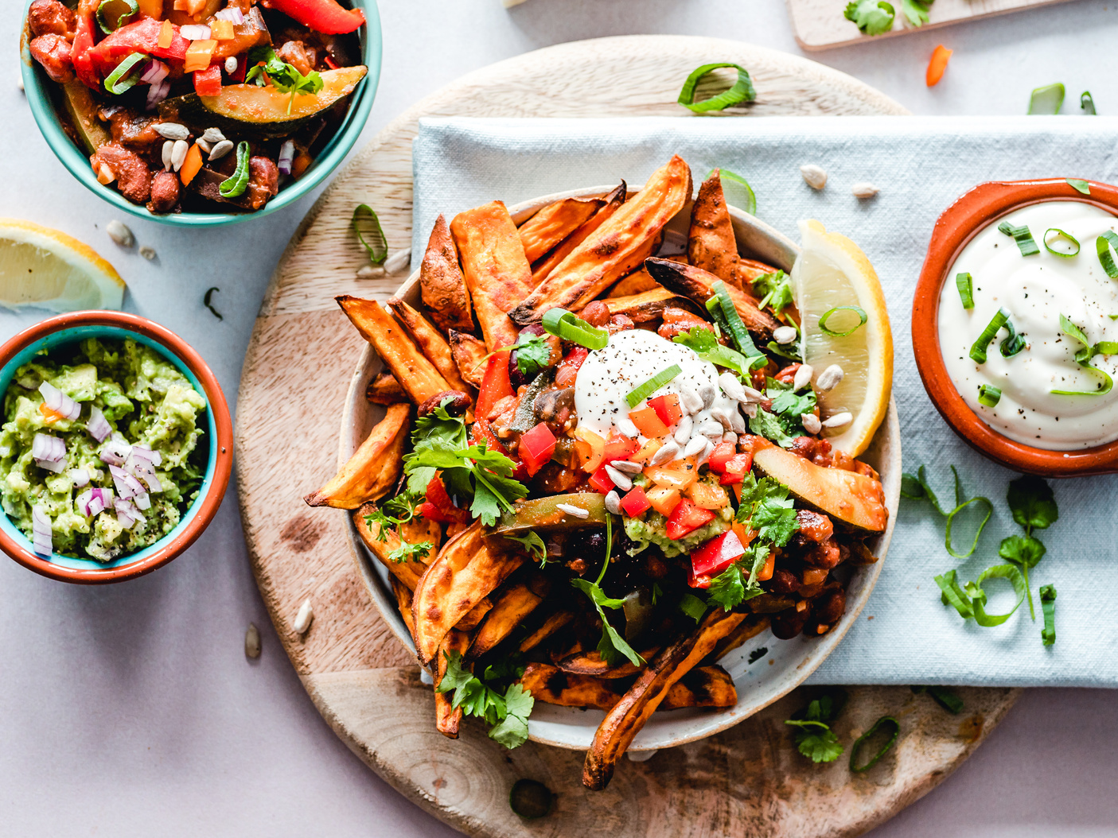

Demo
uploading ingredient images and receiving recipe suggestions

Slide 21

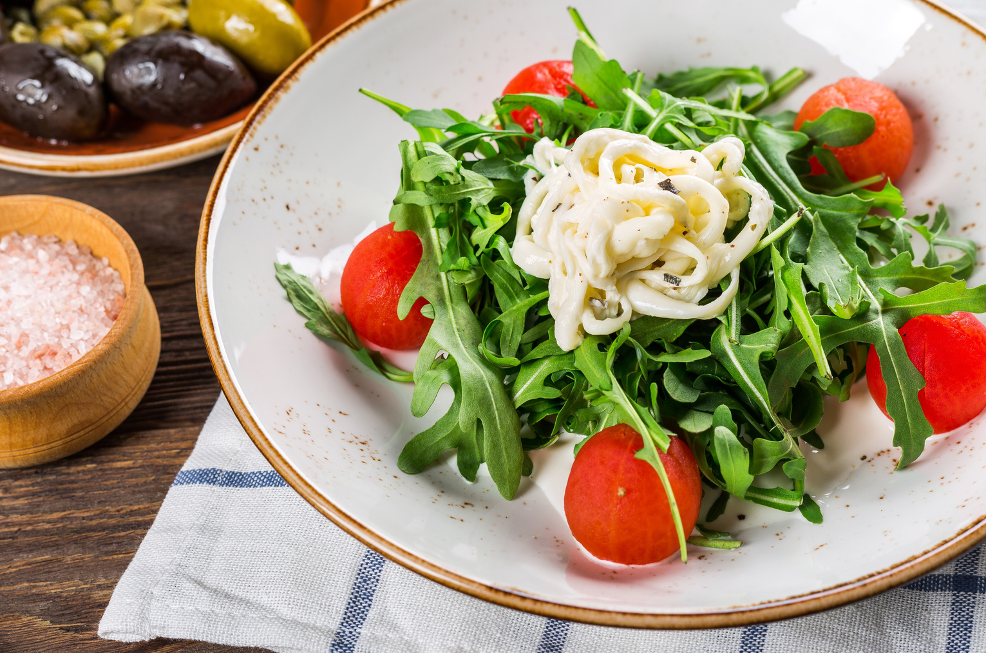
...Thank you

